Slide 1



JAVA MICRO PROJECT
PR D (19ITR028)
PROJECT GUIDE
Mentor Name
Designation
PROJECT MEMBER
Birundha K
Notes:
30 June 2023
1-59
<number>

Slide 2
PROBLEM STATEMENT
Develop an Accounting Application that allows businesses to manage their financial transactions efficiently. The application will enable users to handle tasks such as recording transactions, managing ledgers, generating financial reports, calculating taxes, and managing invoices. The goal is to simplify financial management for small and medium-sized businesses by providing a centralized platform for their accounting needs..

Slide 3
MODULES AND CONCEPT
User Management Module:
Concepts: Inheritance, Encapsulation, and Polymorphism.
Transaction Management Module:
Concepts: Encapsulation
Ledger Management Module:
Concepts: Data encapsulation, state management.
Report Generation Module:
Concepts: Encapsulation, Abstraction.
Invoice Generation Module:
Concepts: Object-Oriented Modeling.
Tax Management Module:
Concepts: Encapsulation and reusability.
<number>

Slide 4
CODE
import java.util.Date;
public abstract class FinancialTransaction {
protected Date date;
protected double amount;
protected String description;
public FinancialTransaction(Date date, double amount, String description) {
this.date = date;
this.amount = amount;
this.description = description;
}
public abstract String getType();
public Date getDate() {
return date;
}
public double getAmount() {
return amount;
}
public String getDescription() {
return description;
}
}
<number>

Slide 5
import java.util.Date;
public class IncomeTransaction extends FinancialTransaction {
public IncomeTransaction(Date date, double amount, String description) {
super(date, amount, description);
}
public String getType() {
return "Income";
}
}

Slide 6
import java.util.Date;
public class ExpenseTransaction extends FinancialTransaction {
public ExpenseTransaction(Date date, double amount, String description) {
super(date, amount, description);
}
public String getType() {
return "Expense";
}
}

Slide 7
public abstract class Account {
protected String accountNumber;
protected String accountName;
protected double balance;
public Account(String accountNumber, String accountName) {
this.accountNumber = accountNumber;
this.accountName = accountName;
this.balance = 0.0;
}
public abstract void addTransaction(FinancialTransaction transaction);
// Method to get the current balance of the account
public double getBalance() {
return balance;
}
public String getAccountNumber() {
return accountNumber;
}
public String getAccountName() {
return accountName;
}
}

Slide 8
public class AssetAccount extends Account {
public AssetAccount(String accountNumber, String accountName) {
super(accountNumber, accountName);
}
public void addTransaction(FinancialTransaction transaction) {
if (transaction.getType().equals("Income")) {
balance += transaction.getAmount();
} else if (transaction.getType().equals("Expense")) {
balance -= transaction.getAmount();
}
}
}

Slide 9
public class LiabilityAccount extends Account {
public LiabilityAccount(String accountNumber, String accountName) {
super(accountNumber, accountName);
}
public void addTransaction(FinancialTransaction transaction) {
if (transaction.getType().equals("Income")) {
balance -= transaction.getAmount();
} else if (transaction.getType().equals("Expense")) {
balance += transaction.getAmount();
}
}
}

Slide 10
import java.util.ArrayList;
import java.util.List;
public class Ledger {
private List<FinancialTransaction> transactions;
private List<Account> accounts;
public Ledger() {
transactions = new ArrayList<>();
accounts = new ArrayList<>();
}
public void addTransaction(FinancialTransaction transaction) {
transactions.add(transaction);
for (Account account : accounts) {
account.addTransaction(transaction);
}
}
public void addAccount(Account account) {
accounts.add(account);
}
public void generateReport() {
System.out.println("Account Balances:");
for (Account account : accounts) {
System.out.println(account.getAccountName() + " (" + account.getAccountNumber() + "): " + account.getBalance());
}
}
}

Slide 11
MAIN CLASS
import java.util.Date;
public class AccountingApp {
public static void main(String[] args) {
Ledger ledger = new Ledger();
AssetAccount assetAccount = new AssetAccount("1001", "Cash");
LiabilityAccount liabilityAccount = new LiabilityAccount("2001", "Accounts Payable");
EquityAccount equityAccount = new EquityAccount("3001", "Owner's Equity");
ledger.addAccount(assetAccount);
ledger.addAccount(liabilityAccount);
ledger.addAccount(equityAccount);
FinancialTransaction income = new IncomeTransaction(new Date(), 5000.0, "Sale of product");
FinancialTransaction expense = new ExpenseTransaction(new Date(), 2000.0, "Purchase of raw materials");
ledger.addTransaction(income);
ledger.addTransaction(expense);
ledger.generateReport();
}
}

Slide 12
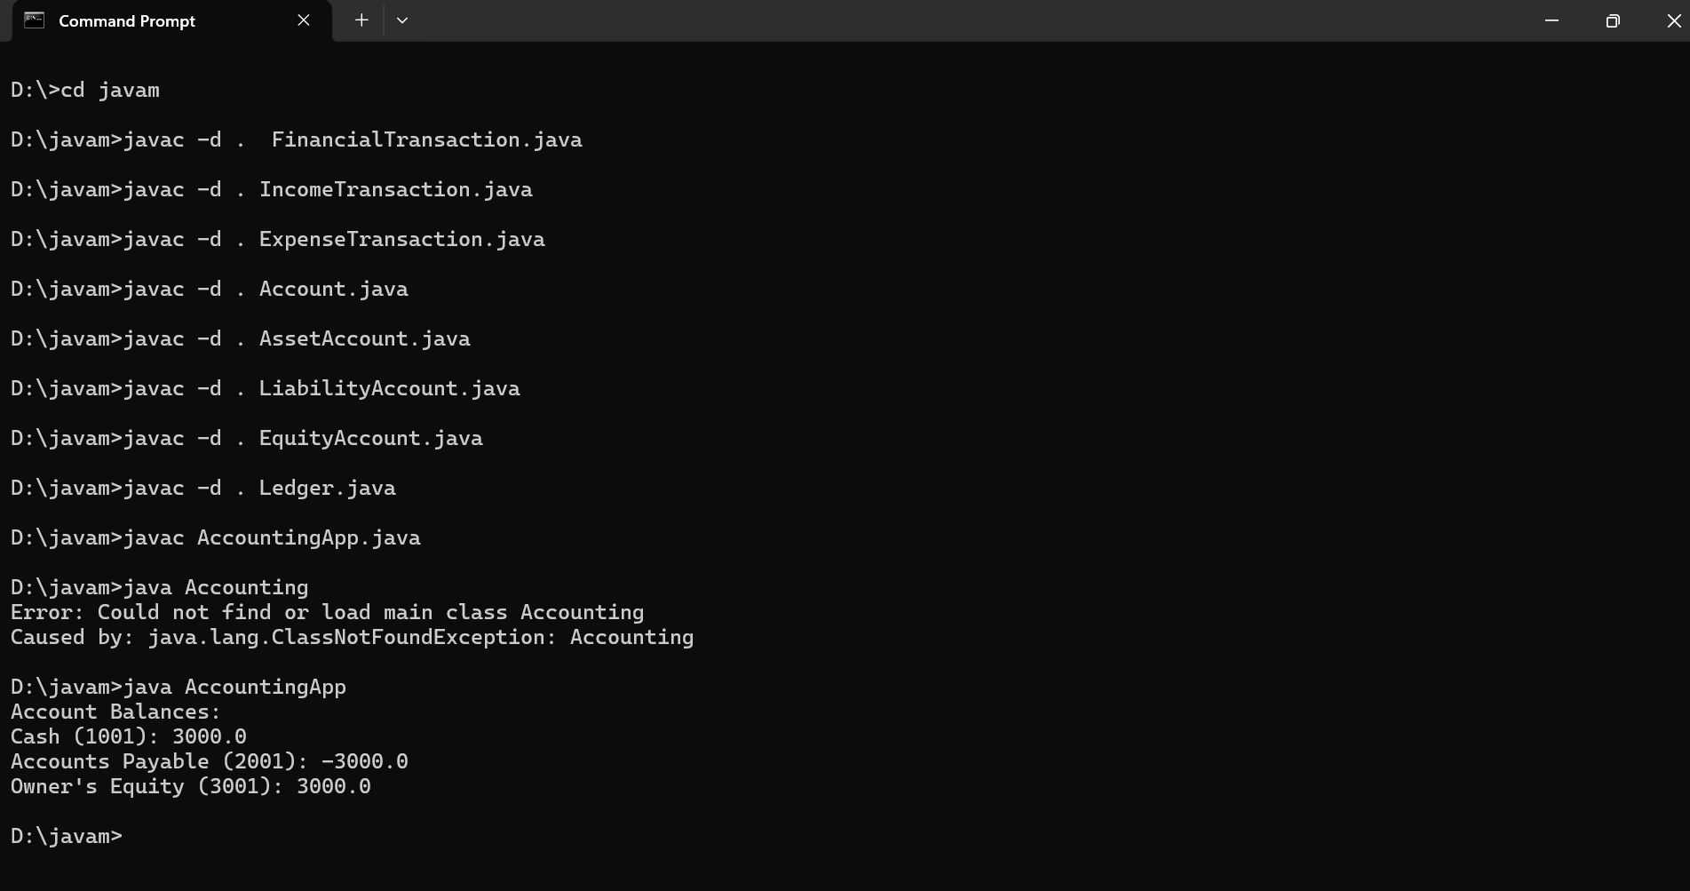

Slide 13
CONCLUSION
The Accounting App streamlines financial management by providing a comprehensive suite of tools tailored for user roles like Admin and Accountant.
This application enhances efficiency, reduces errors, and ensures accurate financial record-keeping, making it a valuable asset for any organization.

Slide 14
THANK YOU

